Slide 1
On the configuration and use of github and git bash at NUTH
Daniel Weiand
ILM directorate clinical informatics lead

Slide 2
Aims of talk
Introduce git, incl github and git bash [or Rstudio terminal]
Discuss IT requirements to access github and git bash
Consider different uses of github

Slide 3
git
Git is a distributed version control system that allows used to track changes to code (and files) over time and collaborate with others.
Git allows users to create “branches” to work on features independently.
“Branches” can be “merged” to integrate changes.

Slide 4
github
GitHub is a web-based platform built around Git that provides tools for collaborating on code.
Github can be used to:
Host remote “repositories”,
Manage access controls,
Track “issues”,
Review code changes through “pull requests”,
Automate workflows.

Slide 5
git bash
Git Bash is a command line interface for interacting with git “repositories” on Windows.
Git bash provides a Unix-style terminal and bash shell, allowing Windows users to use standard Git commands and workflows from the command line.
[The RStudio terminal can be used instead of git bash]

Slide 6
IT requirements permissions
Users must be added to a special “cyber security exception policy”
Contacts incl: Alan Richardson (IT security officer) & Mark Bell (information security specialist)
Ring 21000 to have:
github desktop installed
git bash installed
Ring 21000 to have RStudio installed (ask to be added the “SCCM-R” group)

Slide 7
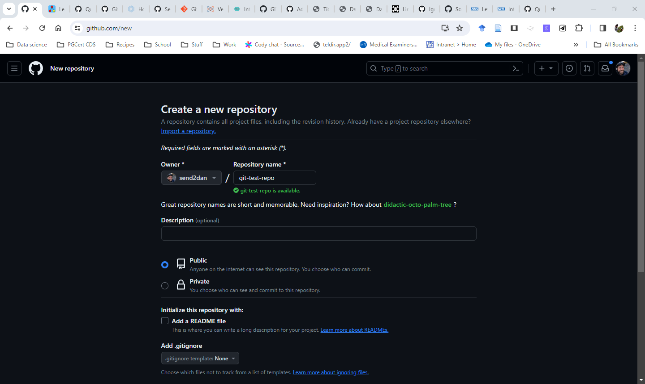

Slide 8
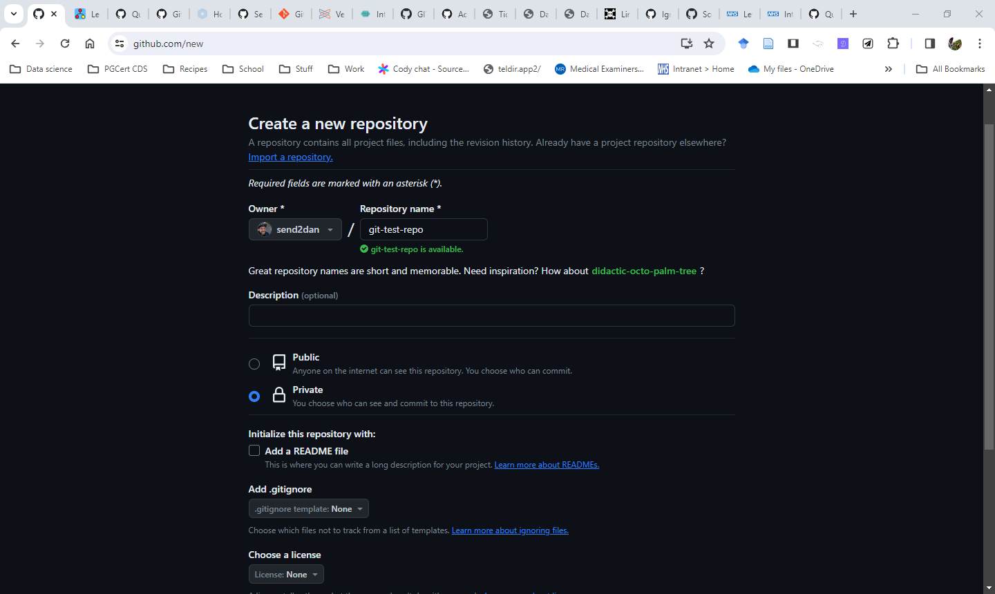

Slide 9
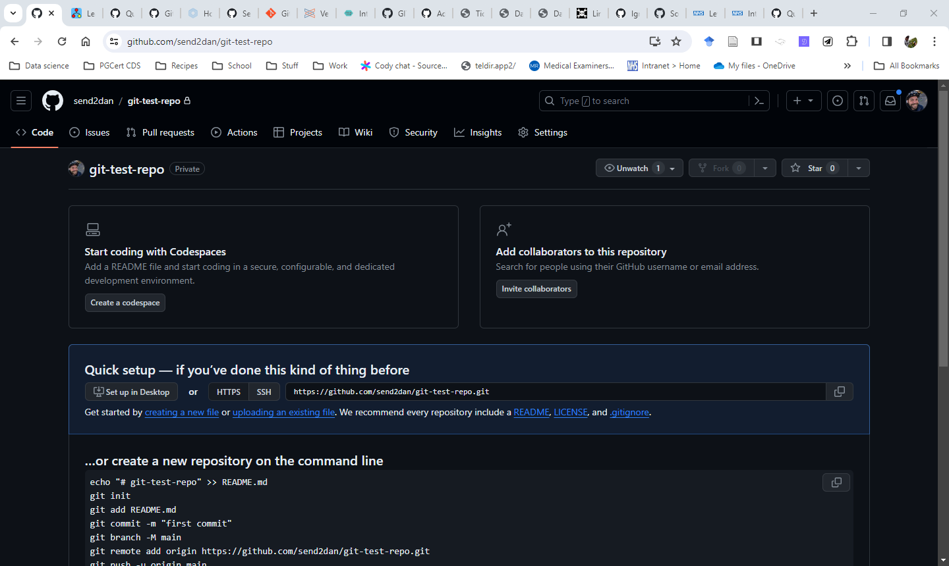

Slide 10
Next steps to “push” an existing repository
# Set working directory #
#######################
cd '\Users\Weiandd2\Documents\git-test-repo'
git init

Slide 11
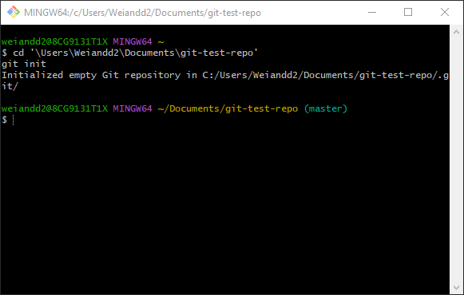

Slide 12
# Set remote directory #
#######################
git remote add origin https://github.com/send2dan/git-test-repo.git

Slide 13
# To verify that you set the remote URL correctly, run the following command. #
########################
git remote -v

Slide 14
# allow long files and use .gitignore #
########################
git config --global core.longpaths true
git config --global core.excludesFile 'Users/Weiandd2/Documents/.gitignore'

Slide 15
# add files #
########################
git status
git add .
# commit with a message #
########################
# git commit -a -m "[descriptive message]" #
git commit -a -m "added new file"

Slide 16
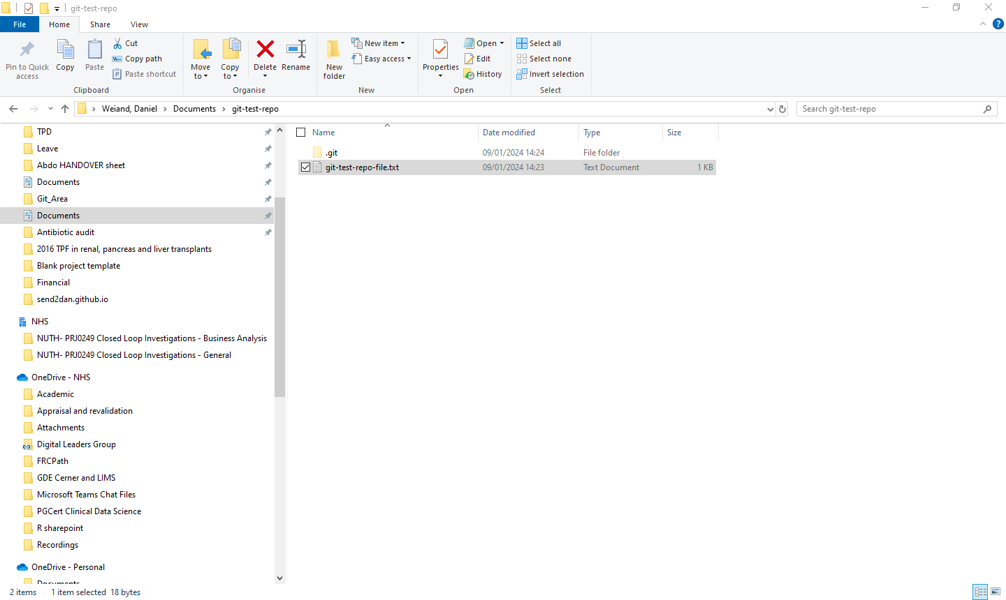

Slide 17
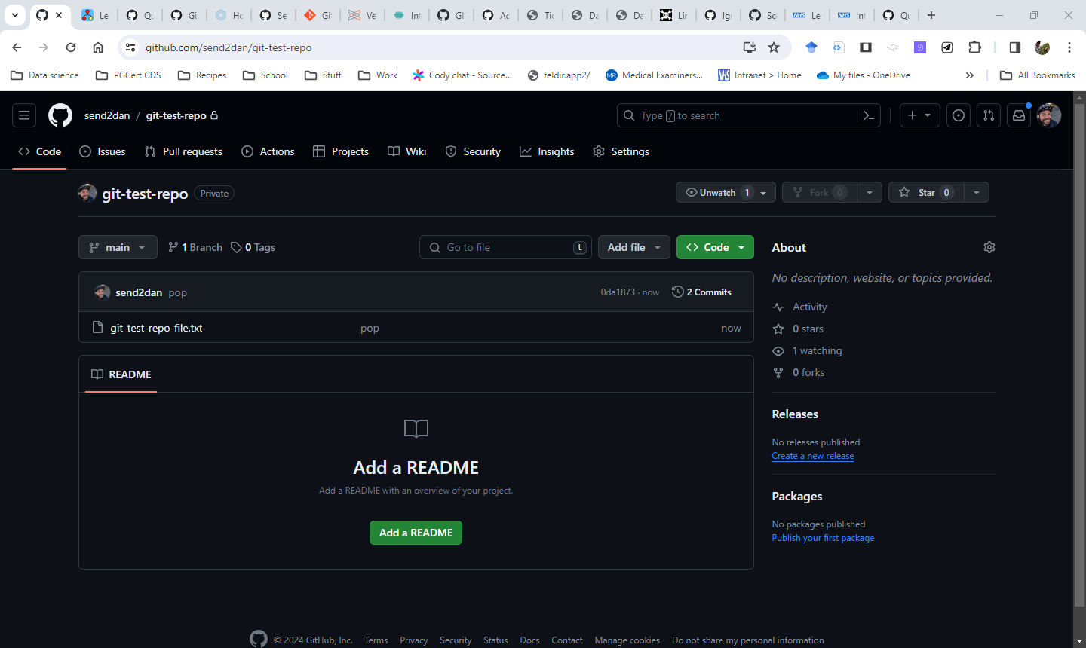

Slide 18
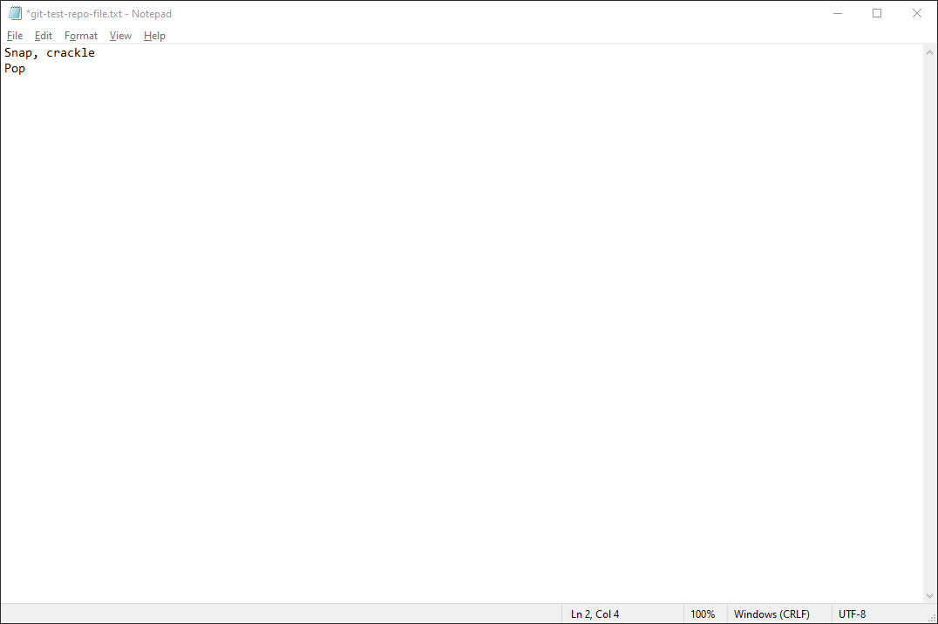

Slide 19
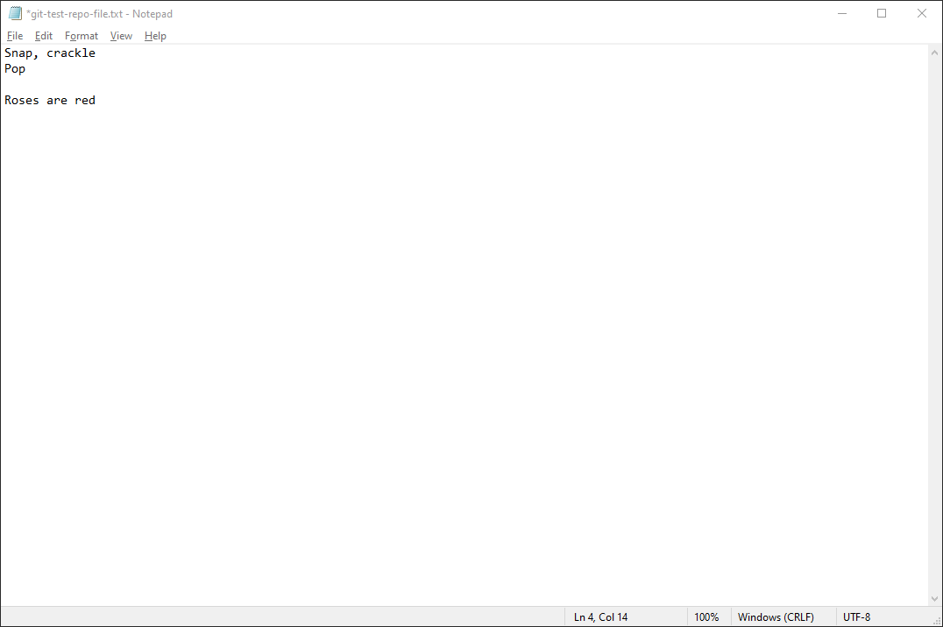

Slide 20
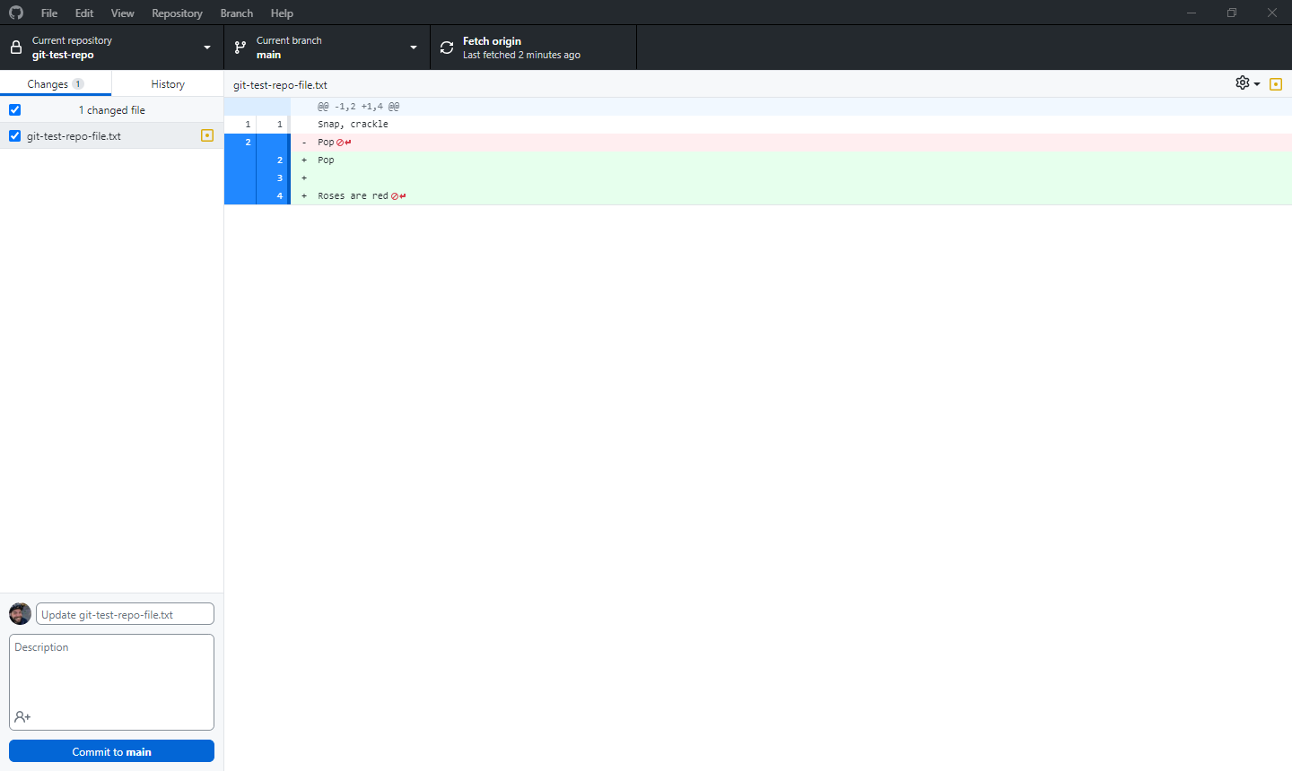

Slide 21
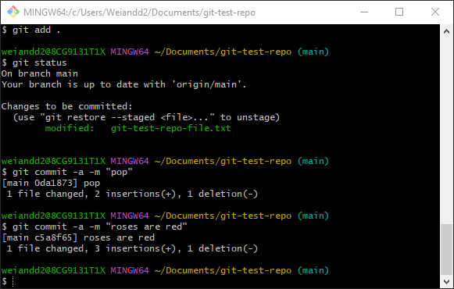

Slide 22
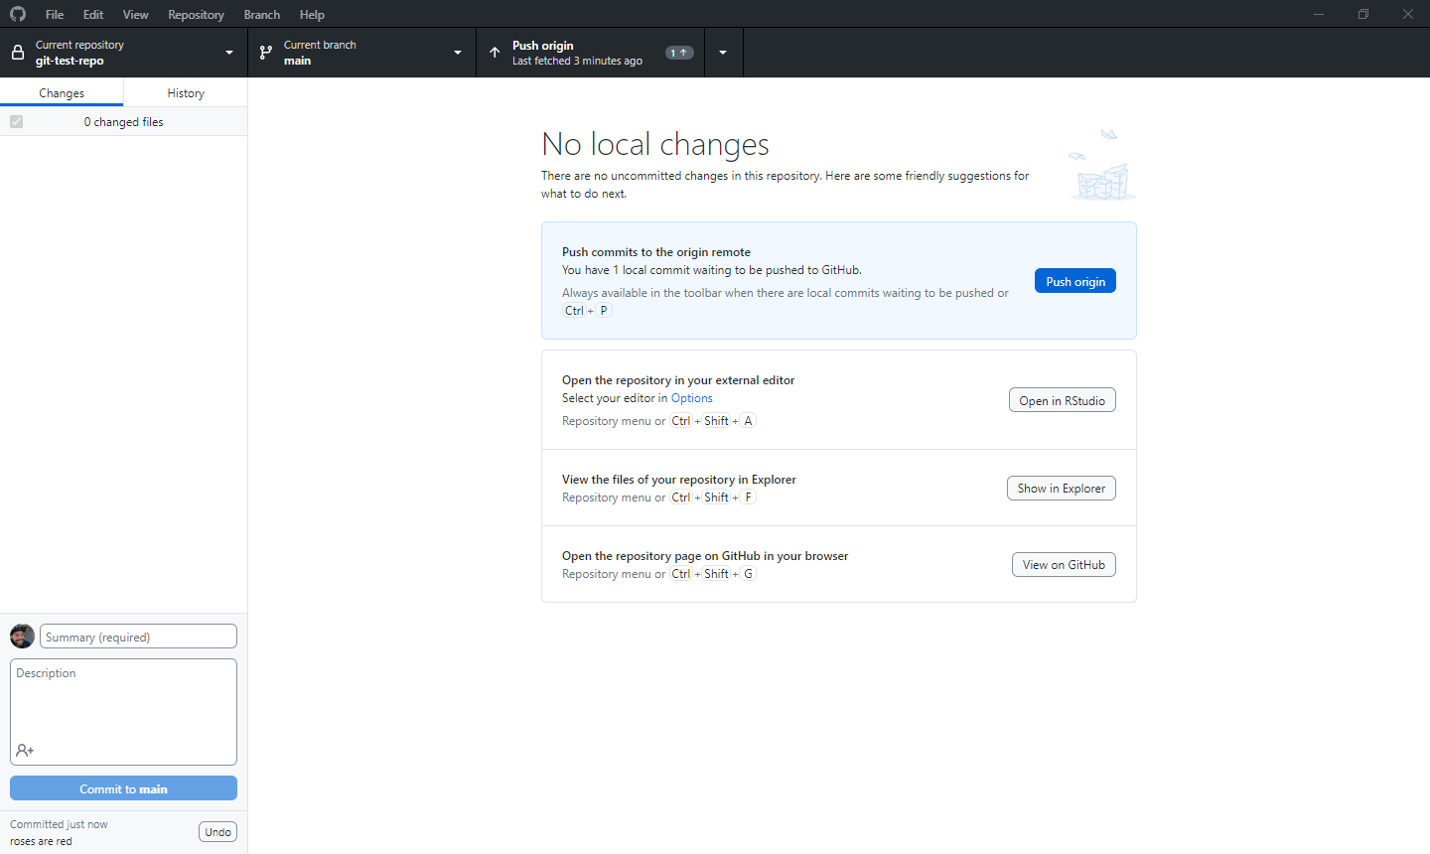

Slide 23
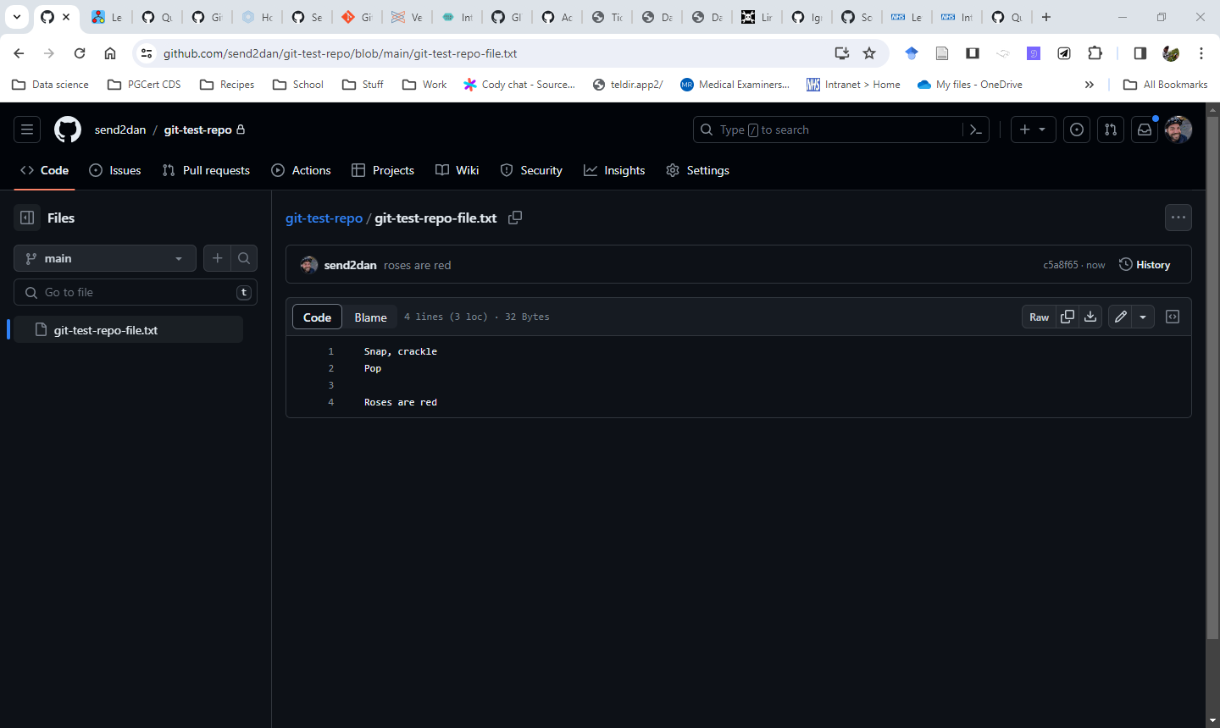

Slide 24
Let’s time travel
# checkout what happened two commits ago #
########################
git checkout main^^

Slide 25
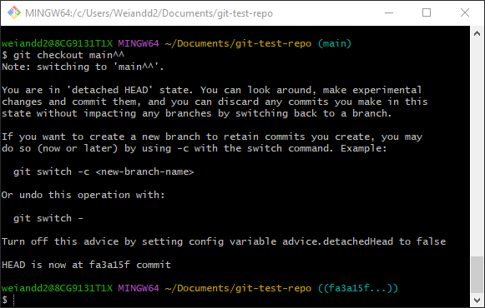

Slide 26
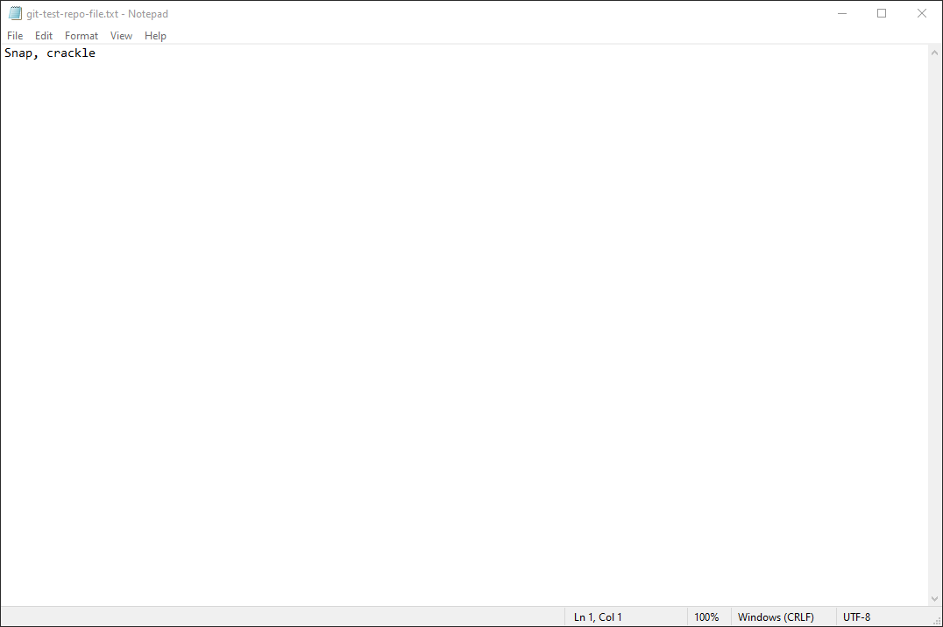

Slide 27
Let’s go back to the latest version
# checkout the latest version #
########################
git checkout main

Slide 28
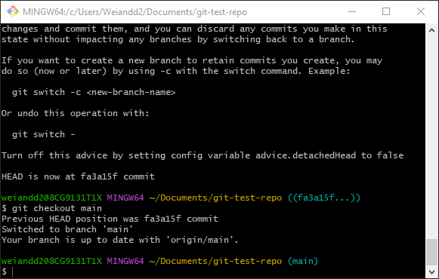

Slide 29


Slide 30
Git Branches
Branches in git are simply pointers to a specific commit -- nothing more.
# create new branch called “poem” #
########################
git branch poem
git checkout poem

Slide 31
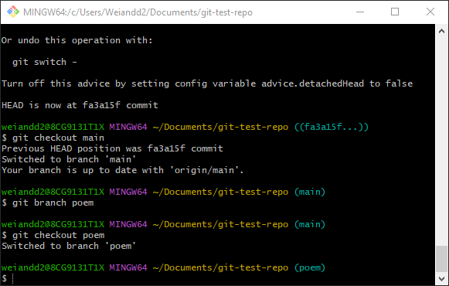

Slide 32
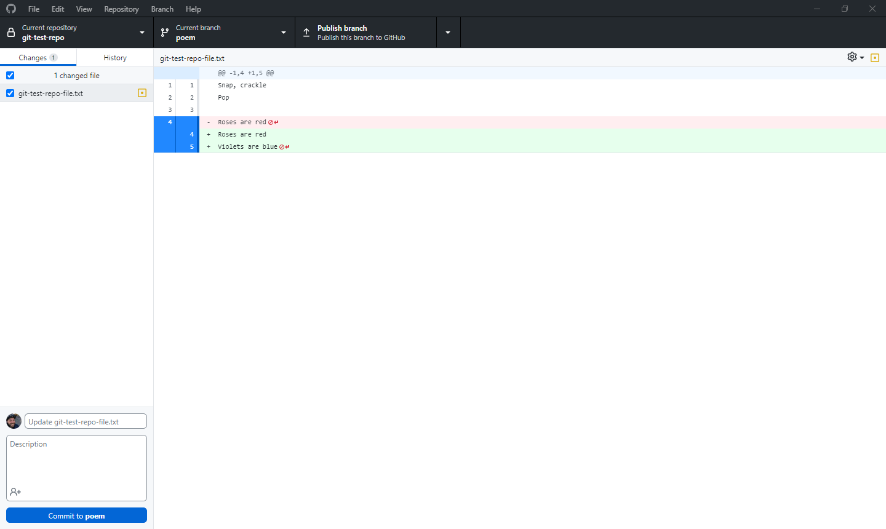

Slide 33
New commit
# commit with a message #
########################
# git commit -a -m "[descriptive message]" #
git commit -a -m “violets are blue"

Slide 34
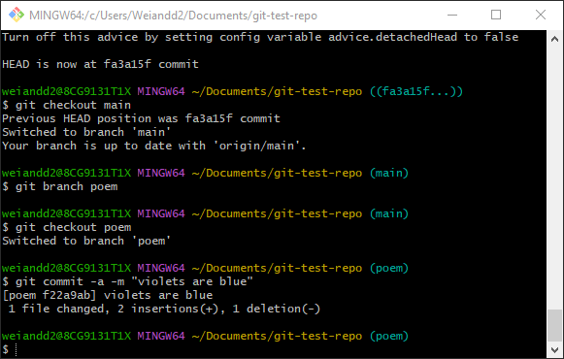

Slide 35
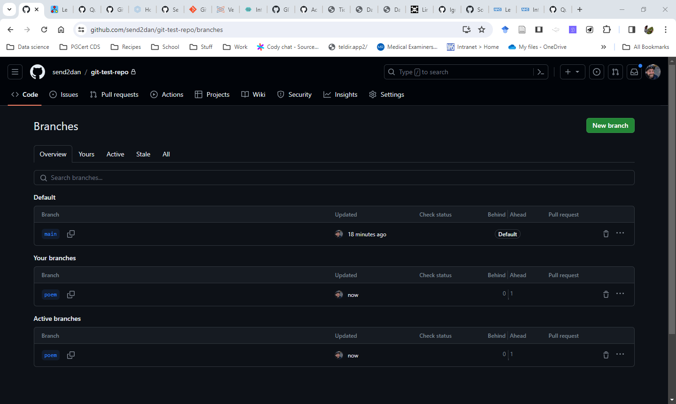

Slide 36
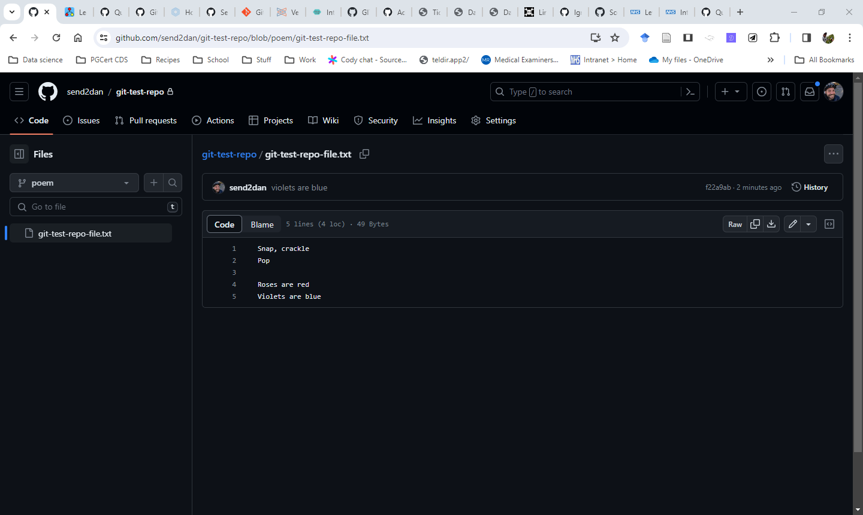

Slide 37
Practicing git commands safely
https://learngitbranching.js.org/

Slide 38
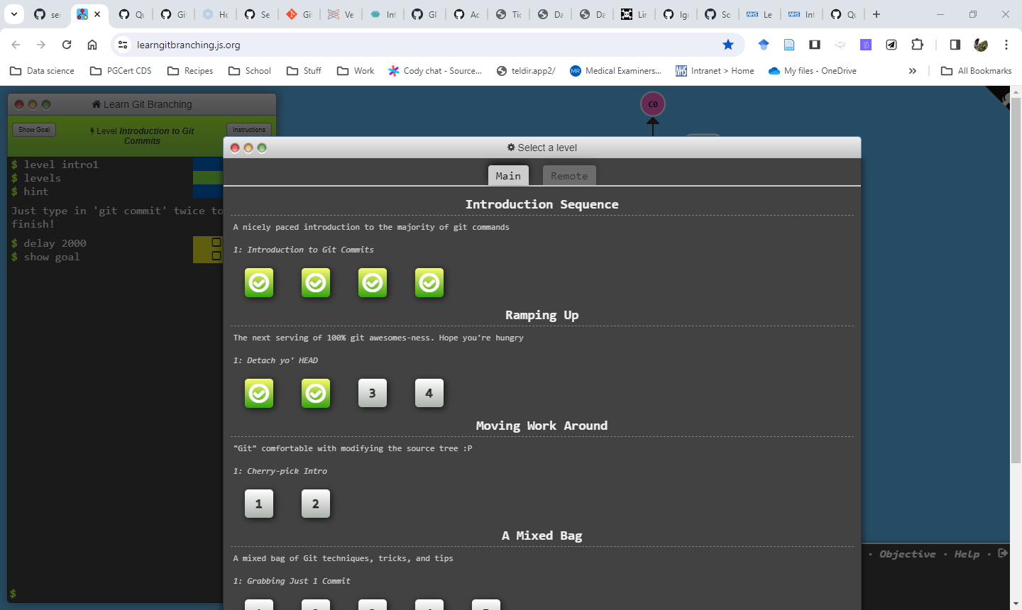

Slide 39


Thanks for listening!
Further information
Daniel Weiand, Consultant medical microbiologist
Newcastle upon Tyne Hospitals NHS Foundation Trust
Email: dweiand@nhs.net
NHS-R community blog:
https://nhsrcommunity.com/author/daniel-weiand/
Twitter: send2dan
Github: github.com/send2dan/public

Slide 40
More useful resources to learn git (and github)

Slide 41
https://support.posit.co/hc/en-us/articles/200532077
a blog post by the makers of RStudio on Version Control with Git and SVN
https://rfortherestofus.com/2021/02/how-to-use-git-github-with-r/
a blog post that has gotten so much interest that it’s been turned it into a full-length course
https://git-scm.com/book/en/v2
a comprehensive, free online book created by the Git project to document how to use Git version control.

Slide 42
https://code-review.tidyverse.org/
Tidyteam code review principles
https://gist.github.com/etoxin/1acb257550b1de60fe99
Glossary of common git bash Commands
https://ourcodingclub.github.io/tutorials/git/
An online introductory tutorial to github for version control

Slide 43
https://the-strategy-unit.github.io/data_science/style/git_and_github.html
Guide on using git and github created by the NHS-R team
https://youtu.be/RGOj5yH7evk
Git and github crash course
https://docs.github.com/en/get-started/getting-started-with-git/ignoring-files & https://gist.github.com/octocat/9257657
On creating .gitignore files

Slide 44
https://nhsdigital.github.io/rap-community-of-practice/training_resources/git/introduction-to-git/
NHS RAP community of practice introduction to git
https://docs.github.com/en/pages/quickstart
Hosting websites using github pages

